Slide 1
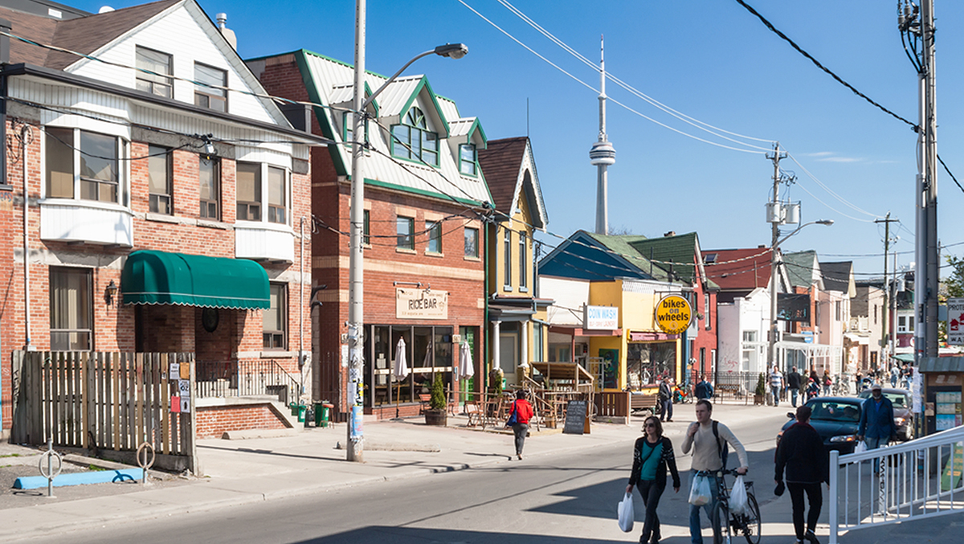
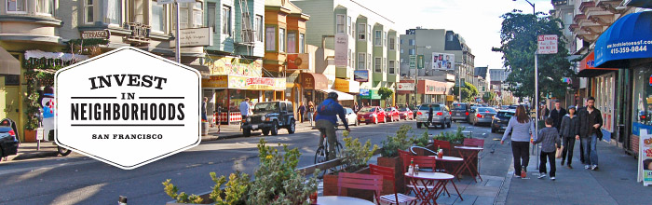
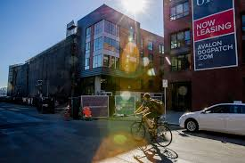
Predicting Gentrification Using Machine Learning

Slide 2
Neighborhood Characteristics Before Gentrification
Older Housing Stock
Long-time Residents
High Racial Diversity
Low Income
High Percent of Rentals
Use of Public Transportation

Slide 3
Gentrification In Progress
Investment Comes Into Neighborhood
New Housing
New Upscale Businesses
Investment in new public transportation (i.e. Light Rail Systems)
Area Becomes More Desirable To Higher Income Buyers
Rents Increase – Low Income Residents Get Displaced

Slide 4
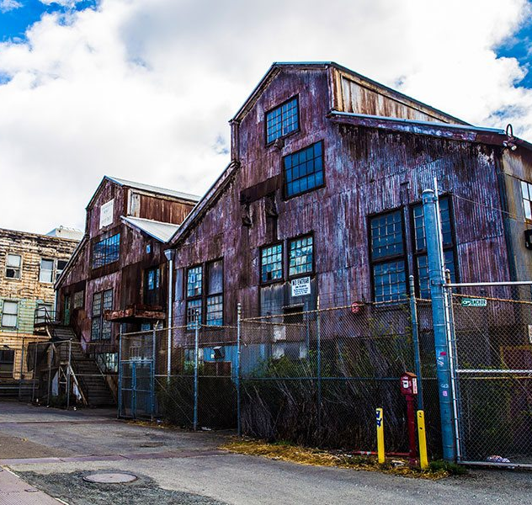
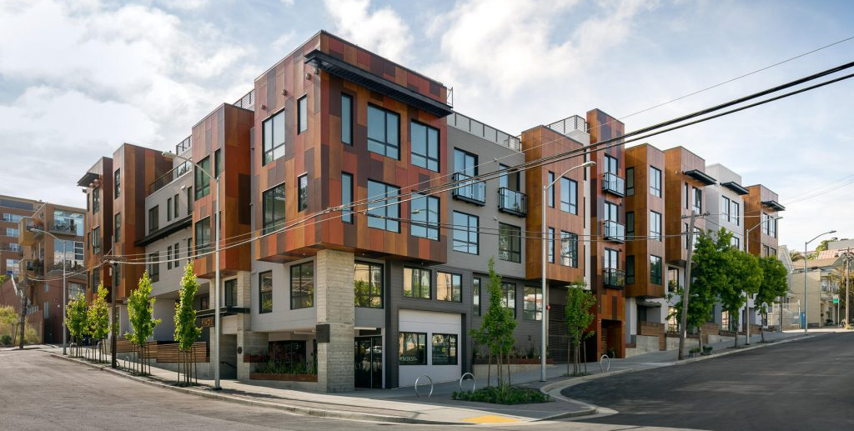
Gentrification
Can Machine Learning provide early notice of Gentrification?
Would early warning enable Policy Makers to minimize Displacement while still enabling neighborhood revitalization?

Slide 5

Team-Blue-MW The Details of the Project

Slide 6

GentrifyPredict Project Milestones
Identify Data Sources correlated To Gentrification
Preprocess Data for Machine Learning
Test Various ML Models for Accuracy
Define Final dB Schema and wrangle data to fit
Setup Cloud DB and Connect Model
Define and Build Visual Presentation Layer
Predict and Display “Early Notice” Neighborhoods
Team-Blue-MW
Is On This Step

Slide 7

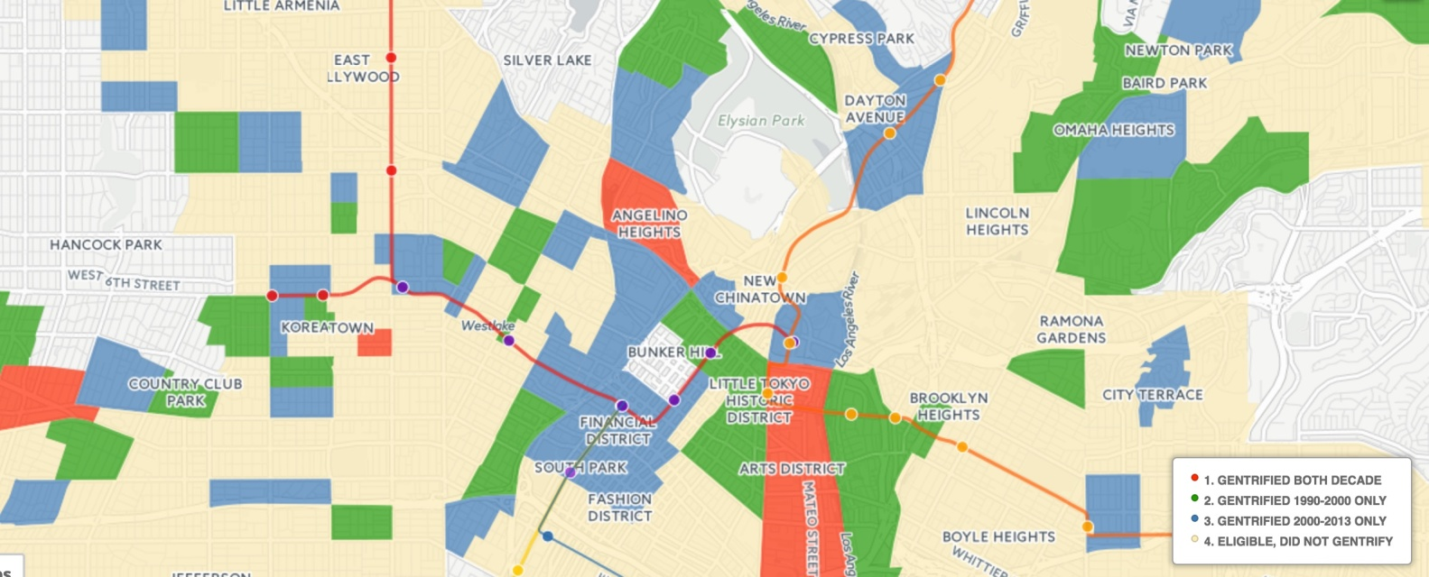
GentrifiedPredict Technology Stack
Data Pipeline Layer
AWS S3 Server
CSV Flat Files
AWS RDS
Structured Data
Use Python/Pandas
To Read CSV Into DFs
Use Python/Pandas To Wrangle Data Into Schema
SQL Code To Build Tables and Load DF Into Server
1
2
3
4
Gradient Boost ML Algorithm
X1
X2
X3…etc.
Machine Learning Layer
Presentation Layer
Python/Scikit-Learn
Read In Data
Preprocess for ML
Split Train/Test
Train Model
Test Model
Predict
Python/MAP Display
Y Per Location
Y
5
6
7

Slide 8

Machine Learning (X) Features
X Features (Timeframe 2000-2010)
X1 - Percent Change in Rental Price
X2 - Percent Change in Caucasian Resident
X3 - Percent Change in Median Housing Prices
X4 - Percent Change in Median Income
X5- Percent Change In Upscale Businesses
Additional Features Under Consideration
Percent Change in Ranking of K-8 Schools
Presence of Social Services Office (0/1)
College Investments

Slide 9
Proposed Visualization Layer
Color Legend
Blue – Neighboorhoods Predicted To Be High Probability of Gentrifying Y=1
All Other Neighborhoods Y=0

